Slide 1
OBJECTIVES
Parkinson's disease is a progressive disorder that affects the nervous system and the parts of the body controlled by the nerves.
Symptoms start slowly. The first symptom may be a barely noticeable tremor in just one hand. Tremors are common, but the disorder may also cause stiffness or slowing of movement.
Millions of deaths can be prevented through early detection of Earlier Parkinson’s disease detection using Magnetic Resonance Imaging (MRI) may increase patient's survival rate. In MRI, Parkinson’s Disease is shown more clear.

Slide 2
INTRODUCTION
The aging of today’s society is associated with an increasing number of patients suffering from neurodegenerative disorders.
The clinical presentations of PD include progressively slowing movements, limb rigidity, restremor, and
posture instability . Unfortunately, even those patients who receive dopaminergic treatment or deep brain stimulation still deteriorate with increasing age, and their mortality rate is two- to three-fold higher than that of the general population.
Therefore, recognizing PD in its early stage is critical for initiating proper treatments to decrease morbidity and ease the medical burden in the elderly The clinical severity of PD can be divided into five stages, called the Hoehn-Yahr Stages I–V .
In Stage I, the patients experience unilateral symptoms, such as asymmetrical gait or hand swing; in Stage II, the disease influences are bilateral and the patient’s stability degrades; in Stage III, the disease affects the central reflex mechanism, and the patient tends to fall because of trunk instability; in Stage IV, the patient needs a wheelchair and other assistive devices; and in Stage V, the patient is wheelchair bound or even bedridden.

Slide 3
Scope of Project
The performance of the classification model is also biased nowadays. claimed that they achieved an accuracy of 99% and 97.5% separately when employing sustained vowel into PD detection, pointed out that the proposed validation approach is speaker-dependent.
Although the samples in training and testing set a contrast with each other, they can correspond to the same person.
This validation method can lead to an over-optimistic result. In the experiments of claimed this accuracy can even decrease to 60% if the validation process

Slide 4
EXISTING SYSTEM
Parkinson's disease is a neurodegenerative disorder that primarily affects movement control. In the context of diagnosing Parkinson's disease from MRI images, the existing system explores a different path by employing traditional machine learning techniques, specifically the Support Vector Machine (SVM).
This technique contrasts with the proposed deep learning-based approach, aiming to achieve accurate classification by leveraging handcrafted features and a linear decision boundary. The existing system adopts an alternative approach by utilizing SVM for diagnosing Parkinson's disease from MRI images.
While offering an alternative to deep learning, this approach comes with limitations pertaining to feature representation, adaptability, scalability, and the manual nature of feature engineering.
These limitations can affect the accuracy and robustness of the classification system, especially when contrasted with the proposed deep learning-based approach. Accurate and early diagnosis of Parkinson's disease is critical, and the choice of methodology plays a significant role in achieving this goal.

Slide 5
DISADVANTAGES
Handcrafted features might miss subtle image details crucial for accurate Parkinson's disease classification.
SVM struggles with noisy or variable data often found in medical images, affecting classification reliability.
Existing system’s performance suffers when data is scarce or imbalanced, unlike deep learning approaches.
It requires labeled data only, missing out on the potential of utilizing unlabeled data.

Slide 6
PROPOSED SYSTEM
The proposed system has mainly five modules. Dataset, Pre-processing, Split the data, Build CNN with LSTM combined model train Deep Neural network for epochs, and classification. In dataset we can take multiple MRI images and take one as input image.
In pre-processing image to encoded the label and resize the image. In split the data we set the image as 80% Training Data and 20% Testing Data. Then build CNN with LSTM combined model train deep neural network for epochs. Then classified the image as yes or no if PD is positive then it returns yes and the PDr is negative the it returns no.
The proposed framework model includes four stages. First, the input MR image is preprocessed (brain cropping and resizing, data splitting and normalization). Second, the data augmentation technique is used to increase the size of the dataset. The features extracted by the CNN models are classified using the softmax layer.

Slide 7
ADVANTAGES
It is considered as the best DL technique for image classification due to high accuracy.
Image pre-processing required is much less compared to other algorithms.
CNN with combined LSTM has been widely used to solve different problems, but its performance is very good for image processing in health applications.

Slide 8
SYSTEM CONFIGURATION
HARDWARE :
PROCESSOR-I3,I5,I7
RAM – 8 GB
HARD DISK-250 GB
SOFTWARE :
OPERATING SYSTEM - WINDOWS 8/10
LANGUAGE - PYTHON(3.10) VERSION.
SERVER - GUI

Slide 9
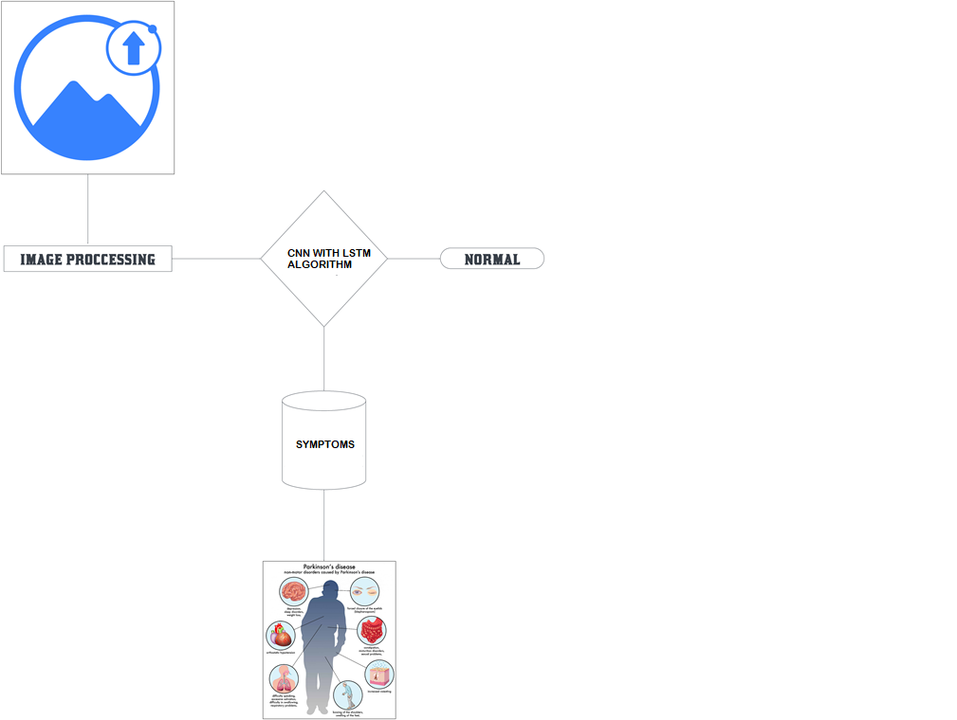
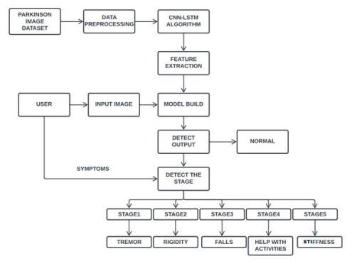
BLOCK DIAGRAM ARCHITECTURE

Slide 10
Modules Description
MODULES LIST:
Image Acquisition
Image Pre-Processing
Feature Extraction
MRI Classification
Convolutional Neural Network with LSTM Algorithm

Slide 11
Proposed System Algorithm
CNN :
Why CNN for Image Classification?
Image classification involves the extraction of features from the image to observe some patterns in the dataset. Using an ANN for the purpose of image classification would end up being very costly in terms of computation since the trainable parameters become extremely large.
For example, if we have a 50 X 50 image of a cat, and we want to train our traditional ANN on that image to classify it into a dog or a cat the trainable parameters become –
(50*50) * 100 image pixels multiplied by hidden layer + 100 bias + 2 * 100 output neurons + 2 bias = 2,50,30
Examples of different filters and their effects
Filters help us exploit the spatial locality of a particular image by enforcing a local connectivity pattern between neurons.
Convolution basically means a pointwise multiplication of two functions to produce
a third function. Here one function is our image pixels matrix and another is our filter. We slide the filter over the image and get the dot product of the two matrices. The resulting matrix is called an “Activation Map” or “Feature Map”.

Slide 12
Step 1: Choose a Dataset
Choose a dataset of your interest or you can also create your own image dataset for solving your own image classification problem. An easy place to choose a dataset is on kaggle.com.
The dataset I’m going with can be found here.
This dataset contains 12,500 augmented images of blood cells (JPEG) with accompanying cell type labels (CSV). There are approximately 3,000 images for each of 4 different cell types grouped into 4 different folders (according to cell type). The cell types are Eosinophil, Lymphocyte, Monocyte, and Neutrophil.
Here are all the libraries that we would require and the code for importing them.
Step 2: Prepare Dataset for Training
Preparing our dataset for training will involve assigning paths and creating categories(labels), resizing our images.
Resizing images into 200 X 200
Step 3: Create Training Data
Training is an array that will contain image pixel values and the index at which the image in the categories list.

Slide 13
Step 4: Shuffle the Dataset
Step 5: Assigning Labels and Features
This shape of both the lists will be used in Classification using the NEURAL NETWORKS.
Step 6: Normalising X and converting labels to categorical data
Step 7: Split X and Y for use in CNN
Step 8: Define, compile and train the CNN Model
Step 9: Accuracy and Score of model

Slide 14
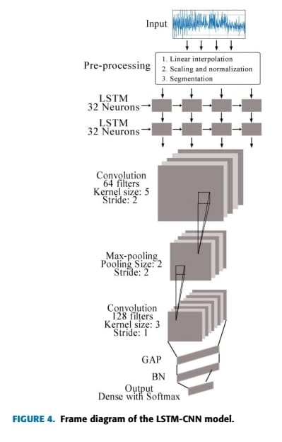
LSTM ALGORITHM

Slide 15
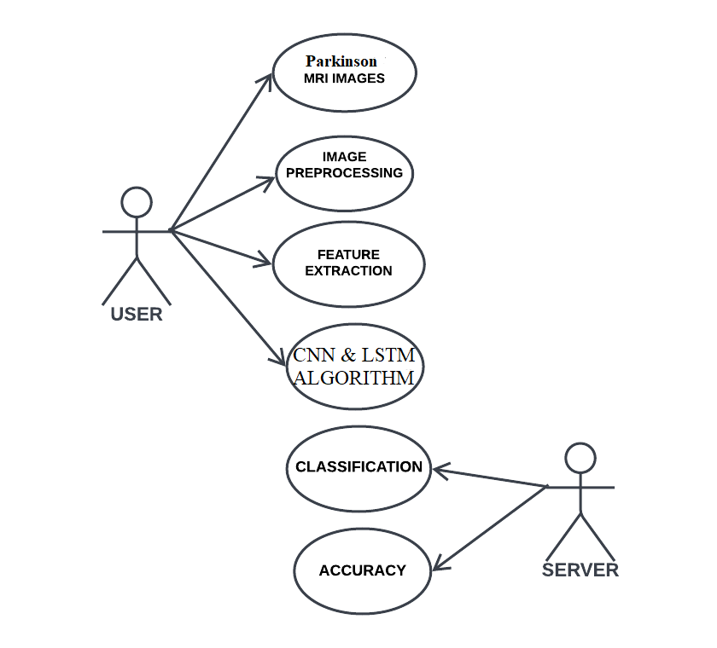
UML DIAGRAM

Slide 16
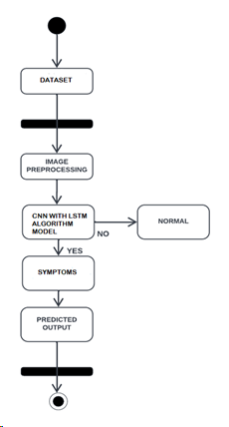
ACTIVITY DIAGRAM

Slide 17
DATA FLOW DIAGRAM
LEVEL 0 :
LEVEL 1 :
LEVEL 2 :

Slide 18
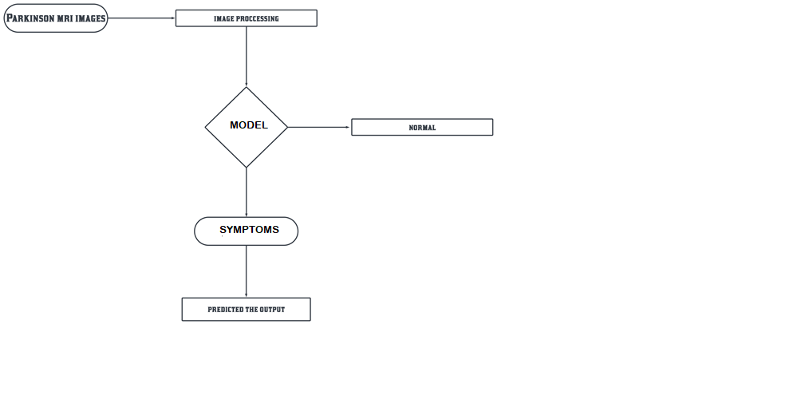
OVERALL DIAGRAM

Slide 19
CONCLUSION
In this study, we used transfer learning to develop a CNN with LSTM combined algorithm model for automatic Parkinson’s disease detection using MR images. Transfer learning uses weights from networks previously trained on millions of data.
The proposed study implements four different transfer learning models with different optimizers (ADAM), and extensive experiments were performed on the two datasets with the largest number of MR images currently available.
For these four models, the features are extracted using transfer learning, and three dense layers along with the softmax layer are used for classification purposes.
The proposed deep TL models shows fast learning by using the Adam optimizer, and the dropout method avoids the problem of overfitting. In future work, the performance of the system can still be improved by using larger data sets and using other deep learning techniques.

Slide 20
THANK YOU

